Slide 1

COS 781 (Data Mining)
Theme 6
Rule Induction

Slide 2
Rule Induction
Further reading:
Peter Clark and Tim Niblett. The CN2 induction algorithm. Machine Learning 3(4):261–283, March 1989.
Appendix A in W. S. van Heerden. Self-Organizing Feature Maps for Exploratory Data Analysis and Data Mining: A Practical Perspective. Master's dissertation, University of Pretoria, Department of Computer Science, April 2017.

Slide 3

What is Rule Induction?
Builds up a set of decision rules
One rule for each class
Nominal and/or continuous descriptive attributes
Nominal classification attribute
Rules are progressively refined
Usually there is a default rule

Slide 4
What is Rule Induction?
Rule sets
Usually include a default rule
Ordered
Rules are evaluated in order, from top to bottom
First matching rule condition gives classification
Unordered
All rule conditions are evaluated
If only one matches, it gives classification
If more than one matches, a resolution scheme must decide on the classification

Slide 5
Rule Induction Terminology
Rule components
Conditions (expressions)
Basic attribute test
A selector
Conjunct of selectors
A complex
Disjunct of complexes
A cover
Classification
Class label

Slide 6
Rule Induction Terminology
Examples of selectors
⟨Cloudy = yes⟩
⟨Weather = wet  stormy⟩
⟨Temp > 60⟩

Slide 7
Rule Induction Terminology
If an expression is true for an example
The expression covers the example
We assume the following axioms:
Empty complex
A conjunct of zero attribute tests
We assume it covers all examples
Empty cover
A disjunct of zero complexes
We assume it covers no examples

Slide 8
AQR
What is AQR?
Implemented by Clark and Niblett
Generic form of AQ algorithm by Michalski

Slide 9
AQR: Algorithm Output
Unordered set of decision rules
One for each class
A cover that predicts a class label
Classification of new examples
Find set of rules that cover the new example
If this set contains one rule
That rule’s class is predicted
If this set contains more than one rule
Predicts most common class of training example covered by the set
If no rules cover the example, default rule triggered
Predicts most commonly class in the training set

Slide 10
AQR: Algorithm Overview
Iteratively builds a cover for each class
Stage 1
Select an un-covered example
Build a cover one complex at a time
Stage 2
Remove training examples covered by complex
Repeat until enough complexes are found
That cover all examples of the class
But cover no negative examples

Slide 11
AQR: Algorithm Overview
The process is called a beam search:
A series of hill-climb searches in parallel
Only specialisations are considered that
Exclude negative examples while
Still covering a “seed” positive example

Slide 12
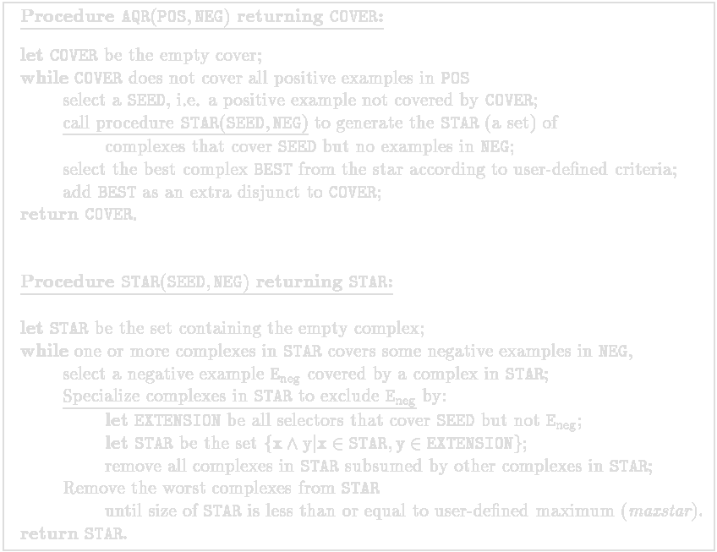
AQR: Algorithm Overview
Performed once for every class
Covers no positive examples
Set of newly generated complexes
Covers all negative examples
Find all conditions that exclude a negative example
Specialise every complex in STAR using every new condition
Prune STAR before excluding more negative examples

Slide 13
AQR: Heuristic Functions
“Best complex” is added as a new disjunct to COVER
Chosen using a heuristic
Complex that covers the maximise number of positive examples
Because we know that no negative examples are covered and at least one positive example is covered
“Worst complexes” are removed from STAR
Chosen using a heuristic
Low sum of positive examples covered and negative examples excluded
Optimises search by excluding poorly performing complexes
In the case of ties:
Complexes with fewer selectors are considered better
Favours less complex conditions

Slide 14
AQR: Heuristic Functions
Positive example (SEED) selection:
Randomly chosen
Negative example (E_{neg}) selection:
Closest to SEED selected first
Determined using a distance
Number attribute values differ between SEED and E_{neg}
If SEED and E_{neg} have same attribute values
In other words the distance is 0
E_{neg} is ignored

Slide 15
CN2
Evolved from earlier AQ algorithms
Current Version (6.1)
http://www.cs.utexas.edu/users/pclark/software/
Designed in 1989 by
Peter Clark
Tim Niblett
Implementers:
Robin Boswell
Rick Kufrin
Johannes Fuernkranz

Slide 16
Further Reading
Further reading:
Peter Clark and Robin Boswell. Rule induction with CN2: Some recent improvements. In Yves Kodratoff, editor, Proceedings EWSL-91, volume 482 of Lecture Notes in Computer Science, pages 151 – 163, Porto, Portugal, 6 – 8 March 1991. Springer Verlag.

Slide 17
CN2: Algorithm Output
Ordered set of decision rules (decision lists)
Same structure as AQR uses
Unordered rules also possible (see further reading)
Classification of new examples
Apply rules in order, from top to bottom
If a rule covers the example, its class is predicted
Therefore, order is important
If no rules cover the example default rule triggered
Predicts most commonly occurring class in the training set

Slide 18
CN2: Algorithm Overview
Problem with AQ algorithm
Doesn’t deal with noise well
Why is this?
Search for complexes is too specific
Complexes must be 100% consistent with training data
The CN2 algorithm
Uses the basic AQR beam search, but
Removes the dependence on specific examples during the beam search
Extends the search space to include rules that do not perform perfectly on the training data

Slide 19
CN2: Algorithm Overview
Achieves this by:
Broadening the specialisation process
Consider all specialisations of a complex
Not just those excluding all negative examples while including a seed positive example
Allows for a cut-off method
Stop specialisation once no further statistically significant specialisations are possible

Slide 20
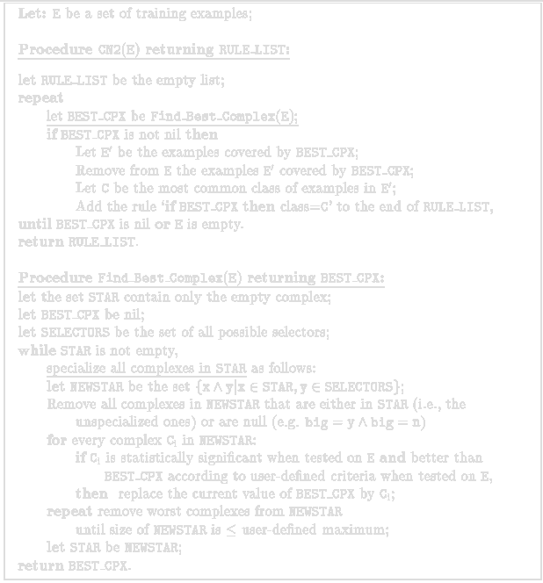
CN2: Algorithm Overview
Performed for entire training set
Build a statistically significant “best” complex for a class C
Remove examples covered by “best” complex
No more “best” complexes that are also statistically significant can be found
STAR covers all examples
Happens when no further complex specialisations can be made
Specialise every complex in STAR using every possible condition
Find “best” complex of all that are also statistically significant
Prune “worst” complexes before specialising again

Slide 21
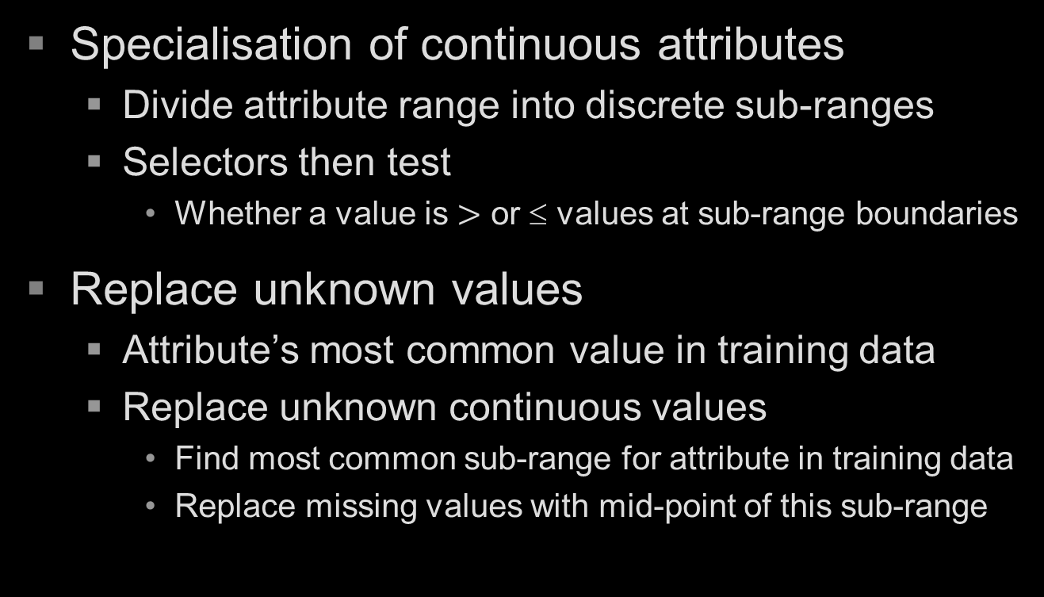
CN2: Algorithm Overview
Specialisation of continuous attributes
Divide attribute range into discrete sub-ranges
Selectors then test
Whether a value is $>$ or ≤ values at sub-range boundaries
Replace unknown values
Attribute’s most common value in training data
Replace unknown continuous values
Find most common sub-range for attribute in training data
Replace missing values with mid-point of this sub-range

Slide 22
CN2: Heuristics
Quality of complexes
A heuristic that indicates quality when
A complex predicts the majority class it covers
Used when
BEST_CPX is evaluated against new complexes
When pruning STAR

Slide 23
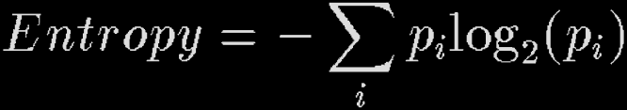
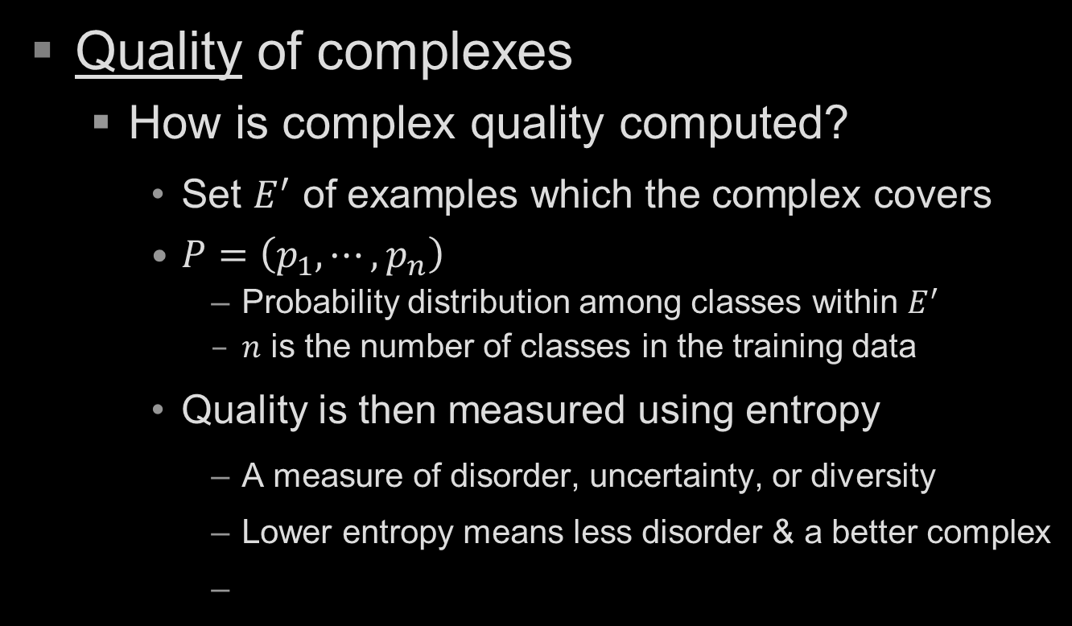
CN2: Heuristics
Quality of complexes
How is complex quality computed?
Set $E^{′}$ of examples which the complex covers
$P=\left(p_{1},⋯,p_{n}\right)$
Probability distribution among classes within $E^{′}$
$n$ is the number of classes in the training data
Quality is then measured using entropy
A measure of disorder, uncertainty, or diversity
Lower entropy means less disorder & a better complex

Slide 24
CN2: Heuristics
Significance of a complex
Indicates whether a complex represents
A pattern unlikely to have occurred by chance
In other words, the reliability of the complex
Used when
BEST_CPX is evaluated against new complexes
Compares
Observed class distribution of data satisfying a complex
Expected class distribution if complex selected data randomly
If the difference too great to be put down to chance
CN2 concludes that the complex is significant

Slide 25
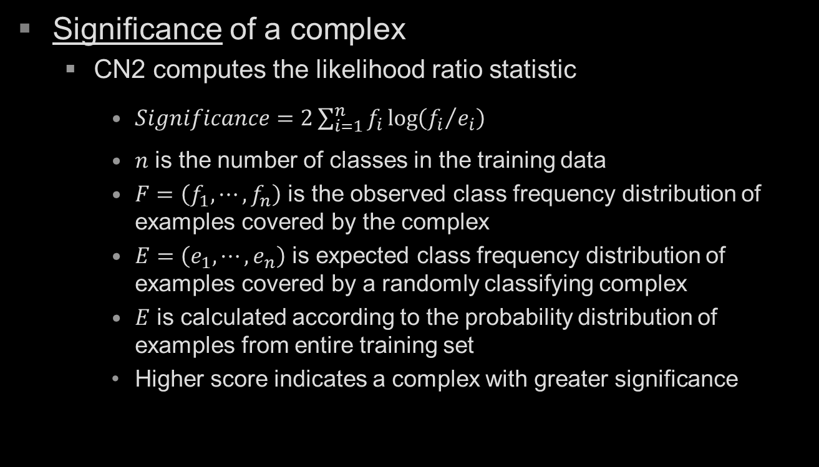
CN2: Heuristics
Significance of a complex
CN2 computes the likelihood ratio statistic
$Significance=2\sum_{i=1}^{n}{f_{i}\log\left({f_{i}}/{e_{i}}\right)}$
$n$ is the number of classes in the training data
$F=\left(f_{1},⋯, f_{n}\right)$ is the observed class frequency distribution of examples covered by the complex
$E=\left(e_{1},⋯, e_{n}\right)$ is expected class frequency distribution of examples covered by a randomly classifying complex
$E$ is calculated according to the probability distribution of examples from entire training set
Higher score indicates a complex with greater significance

